Slide 1
MAKING AVAILABLE RIGHT ACCORDING TO RUSSIAN CIVIL LAW
State educational institution of higher professional education “Russian academy of justice”
Ilya Kondrin
D I S S E R T A T I O N
SECOND PART
Evolutionary development of copyright and neighbouring rights in the system of Russian civil law in conformity with digital technologies
Specialization: 12.00.03 – civil law; business law; family law; international private law
Notes:
1

Slide 2
Evolutionary development of copyright and neighbouring rights in the system of Russian civil law in conformity with digital technologies
WCT
WPPT
WAPT
WTPBO
RUSSIAN LEGISLATION
ACTA

Slide 3
Three stages of development of making available right
2006
Making available right
1
2
1. Introduction in legislation
Federal act № 72-FA 20 July 2004
2. Entry into force
in Russia on 1 January 2006
3. Amendment
- IV part of Russian civil code of Russian Federation enacted on 18 December 2006 - Entered into force on 1 January 2008
2004
2008
3

Slide 4
Copyright Act of RF (CA) and WCT
CA, article 16 item 2 paragraph 11
Article 8 WCT
to communicate the work in such a way that any person may access it in interactive regime from any place and at any time individually chosen by that person (making available right)
Without prejudice to the provisions of Articles 11(1)(ii), 11bis(1)(i) and (ii), 11ter(1)(ii), 14(1)(ii) and 14bis(1) of the Berne Convention, authors of literary and artistic works shall enjoy the exclusive right of authorizing any communication to the public of their works, by wire or wireless means, including the making available to the public of their works in such a way that members of the public may access these works from a place and at a time individually chosen by them.
The wording used in article 16 of CA materially differs from wording used in Article 8 of WCT
(The main differences: definition of “public”; level of interactivity and scope of authority under making available right)
CONCLUSION
Making available right before the IV Part of Russian Civil Code

Slide 5
Definition of “public” in WCT
Qualificatory criterion of the making available right in WCT
Only members of the public, but not the public in whole or any single member of the public, can access work from different places and at different time.
The plural of word “member” in the wording “members of public” is one of the qualificatory criterions of the making available right.
This criterion sets the scope of relevant acts within the “digital transmission”. Thanks to it the making available right does not cover private communications.
Secondly, this criterion is important for definition of interactivity. The interactivity is not only the edge between digital and traditional technologies, but it is also the edge between simultaneous (non-interactive) and non-simultaneous (interactive) transmissions.
“Public” means “members of the public” in plural.
In CA “public” means “any person” in the singular

Slide 6
Definition of “level of interactivity” in CA and WCT
Article 16 of CA and article 8 of WCT do not contain any explicit definition of “interactivity”.
This goal is achieved by means of the wording: “from a place and at a time individually chosen by them”.
Article 8 of WCT defines the level of interactivity to wide extent. It is achieved by using of wording “by wire or wireless means”.
It allows to Article 8 of WCT to cover not only the services that are inherently interactive, for example, digital on-demand services, but also any near interactive services, which are not inherently interactive. The last type of services for the copyright owners and members of the public are considered as maximum “close” to interactive, near interactive.
In order to define the level of interactivity in article 16 CA, the legislator did not use the article 8 WCT, he just used new phrase – “in interactive regime”
As result the level of interactivity has been narrowly defined by the legislator. The simultaneous or non-interactive transmissions have fallen out of the scope of article 16 CA. For example, multi-channel digital radio or television both online and in cable networks.

Slide 7
Permitted by making available right acts under CA and WCT
Digital transmission is a complex operation of constantly interlacing acts. Such acts symbolically can be divided into two stages: initial acts, allowing to make a work available to members of the public, and successive acts.
Article 8 of WCT covers both initial acts and successive acts. It is achieved thanks to using of word “access” in combination with wording “any communication”.
For the purposes of Article 8 of WCT it does not matter at what stage members of the public access a work. The matter is, that at any point of any stage a work is accessible to members of the public.
Under WCT making available right is not limited only by stage to make the work passively available to members of the public.
Under article 16 of CA the make available right has been defined as communication of the work in such a way that any person “can access it in interactive regime”. This definition shows that Russian legislators have not considered the making available right as an element of more broad right - the right of communication to the public.
Article 16 of CA covered thus only initial stage of making available. For example, “uploading” of files in P2P networks.
The acts following the uploading of files, successive acts on making the work available to end user, fell out of the scope of article 16 of CA. For example, “downloading” of files by user in P2P networks.

Slide 8
Copyright Act of RF (CA) and WPPT (Performers)
Article 37 CA, item 2, sub-item 6
Article 10 WPPT
to communicate a fixation of performance to the public in such a way that any person can access it in interactive regime from a place and a time individually chosen by such person (making available right)
Performers shall enjoy the exclusive right of authorizing the making available to the public of their performances fixed in phonograms, by wire or wireless means, in such a way that members of the public may access them from a place and at a time individually chosen by them.
There is fundamental difference between the wording in article 37 CA, item 2, sub-item 6 and the wording in article 10 WPPT
(The main difference: definition of “the public” and level of interactivity)
CONCLUSION
The making available right before the IV part of Russian Civil Code

Slide 9
Definition of “the public” in WPPT (performers)
Qualificatory criterion of the making available right in WPPT
Only members of the public can access performance from different places and at different time, but not the public in whole or any member of the public.
The plural of word “member” in wording “members of the public” is one of the qualificatory criterions of the making available right.
This criterion sets the scope of relevant acts within the “digital transmission”. Thanks to it the making available right does not cover private communications.
Secondly, this criterion is important for definition of interactivity. The interactivity is not only the edge between digital and traditional technologies, but it is also the edge between simultaneous (non-interactive) and non-simultaneous (interactive) transmissions.
“Public” means “members of the public” in the plural
In CA “public” means “any person” in the singular

Slide 10
Definition of “level of interactivity” in CA and WPPT (performers)
There is no such definition as “interactivity” in article 37 CA and article 10 WPPT
This goal is achieved by means of the wording: “from a place and at a time individually chosen by them”
Article 10 of WPPT defines the level of interactivity to wide extent. It is achieved by using of wording “by wire or wireless means”.
It allows to Article 10 of WPPT to cover not only the services that are inherently interactive, for example, digital on-demand services, but also any near interactive services, which are not inherently interactive. The last type of services for the neighbouring rights owners and members of the public are considered as maximum “close” to interactive, near interactive.
In order to define the level of interactivity in article 37 CA, the legislator did not use the article 10 WPPT, he just used new phrase – “in interactive regime”
As result the level of interactivity has been narrowly defined by the legislator. The simultaneous or non-interactive transmissions have fallen out of the scope of article 37 CA. For example, multi-channel digital radio or television both online and in cable networks.

Slide 11
Copyright Act of Russian Federation and WPPT (producers)
Article 38 CA, item 2, sub-item 5
Article 14 WPPT
to communicate a phonogram to the public in such a way that any person can access it in interactive regime from any place and at any time individually chosen by such person (the making available right)
Producers of phonograms shall enjoy the exclusive right of authorizing the making available to the public of their phonograms, by wire or wireless means, in such a way that members of the public may access them from a place and at a time individually chosen by them.
There is fundamental difference between the wording in article 38 CA, item 2, sub-item 5 and the wording in article 14 WPPT
(The main difference: definition of “the public” and level of interactivity)
CONCLUSION
The making available right before the IV part of Russian Civil Code

Slide 12
Definition of “the public” in WPPT (producers)
Qualificatory criterion of the making available right in WPPT
Only members of the public can access phonograms from different places and at different time, but not the public in whole or any member of the public.
The plural of word “member” in the wording “members of the public” is one of the qualificatory criterions of the making available right.
This criterion sets the scope of relevant acts within the “digital transmission”. Thanks to it the making available right does not cover private communications.
Secondly, this criterion is important for definition of interactivity. The interactivity is not only the edge between digital and traditional technologies, but it is also the edge between simultaneous (non-interactive) and non-simultaneous (interactive) transmissions.
“Public” means “members of the public” in the plural
In CA “public” means “any person” in the singular

Slide 13
Definition of “level of interactivity” in CA and WPPT (producers)
There is no such definition as “interactivity” in article 38 CA and article 14 WPPT.
This goal is achieved by means of the wording: “from a place and at a time individually chosen by them”.
Article 14 of WPPT defines the level of interactivity to wide extent. It is achieved by using of wording “by wire or wireless means”.
It allows to Article 14 of WPPT to cover not only the services that are inherently interactive, for example, digital on-demand services, but also any near interactive services, which are not inherently interactive. The last type of services for the neighbouring rights owners and members of the public are considered as maximum “close” to interactive, near interactive.
In order to define the level of interactivity in article 38 CA, the legislator did not use the article 14 WPPT, he just used new phrase – “in interactive regime”.
As result the level of interactivity has been narrowly defined by the legislator. The simultaneous or non-interactive transmissions have fallen out of the scope of article 38 CA. For example, multi-channel digital radio or television both online and in cable networks.

Slide 14
Draft of IV Part of Russian Civil Code and the right to make available
The draft of IV Part of Russian Civil Code has been worked out in accordance with order №694 (02.06.2005) issued by Administration of Russian President. After discussion and consideration by governmental commission on protection and use of intellectual property and against its infringement, the draft was developed (protocol №1, 09.03.2006). In working group have participated following persons: V.F. Yakovlev (В.Ф. Яковлев) – project manager; A.L. Makovsky (А.Л. Маковский) – deputy; G.E. Avilov (Г.Е. Авилов); O.V. Gorodovikov (О.В. Городовиков); O.M. Kozir (О.М. Козырь); E.M. Moiseeva (Е.М. Моисеева); E.A. Pavlova (Е.А. Павлова); P.V. Stepanov (П.В. Степанов); E.A. Suhanov (Е.А. Суханов); L.A. Trahtengerc (Л.А. Трахтенгерц); O.U. Shilohvost (О.Ю. Шилохвост) - executive secretary. V.O. Kalyatin (В.О. Калятин) also personally has participated in drafting of IV Part of Russian Civil Code.
In this document the following provisions contain the right to make available to the public: article 1270, item 2, sub-item 12; article 1317, item 2, sub-item 4; article 1324, item 2, sub-item 5; article 1330, item 2, sub-item 5.
In draft the right to make available to the public was defined almost similarly as it was defined in last redaction of CA (the word “any” before the word “person” was excluded and new phrase “wishing to use it” was added).
As a novation, the circle of objects of neighbouring rights, as applied to the right to make available to the public, was enlarged. In addition to such traditional object of neighbouring rights as a phonogram, a video recording was added to the draft as a new object of neighbouring rights.
As another novation of the draft, the circle of neighbouring rights holders, as applied to the right to make available to the public, was enlarged. Broadcasters have been included in the draft. For these purposes legislator used the following wording: “providing the access to radio- or television broadcast in interactive regime that is in such a way that person, wishing to use it, can do it from any place and at any time individually chosen by such person”.

Slide 15
IV Part of Russian Civil Code and the right to make available
The IV Part of Russian Civil Code has been adopted by Russian State Duma on November 24, 2006. The Council of the Federation has approved it on December 8, 2006. Russian President has signed it on December 18, 2006.
Has entered into force on territory of Russian Federation on January 1, 2008.
In this document the following provisions contain the right to make available to the public: article 1270, item 2, sub-item 11; article 1317, item 2, sub-item 3; article 1324, item 2, sub-item 4; article 1330, item 2, sub-item 5

Slide 16
Circle of subjects of the right to make available to the public as applied to IV part of Russian Civil Code
AUTHORS
PERFORMERS
Article 1270, item 2, sub-item 11
Article 1317, item 2, sub-item 3
IV Part of Russian Civil Code
BROADCASTERS
PRODUCERS
Article 1324, item 2, sub-item 4
Article 1330, item 2, sub-item 5

Slide 17
IV Part of Russian Civil Code and WCT
Article 1270, item 2, sub-item 11
Article 8 WCT
making a work available to the public in such a way that any person can access it from any place and at any time individually chosen by such person (making available to the public)
Without prejudice to the provisions of Articles 11(1)(ii), 11bis(1)(i) and (ii), 11ter(1)(ii), 14(1)(ii) and 14bis(1) of the Berne Convention, authors of literary and artistic works shall enjoy the exclusive right of authorizing any communication to the public of their works, by wire or wireless means, including the making available to the public of their works in such a way that members of the public may access these works from a place and at a time individually chosen by them.
The wording, used in article 1270, item 2, sub-item 11 of Russian Civil Code, is more precisely correspond to the wording contained in article 8 WCT
(The main difference: definition of “the public”)
CONCLUSION
The right to make available under IV Part of Russian Civil Code

Slide 18
IV Part of Russian Civil Code and WPPT (performers)
Article 1317, item 2, sub-item 3
Article 10 WPPT
the right to make a performance available to the public in such a way that any person can access it from any place and at any time individually chosen by such person (making available to the public)
Performers shall enjoy the exclusive right of authorizing the making available to the public of their performances fixed in phonograms, by wire or wireless means, in such a way that members of the public may access them from a place and at a time individually chosen by them.
The wording, used in article 1317, item 2, sub-item 3 of Russian Civil Code, is more precisely correspond to the wording contained in article 10 WCT
(The main difference: definition of “the public”)
CONCLUSION
The right to make available under IV Part of Russian Civil Code

Slide 19
IV Part of Russian Civil Code and WPPT (producers)
Article 1324, item 2, sub-item 4
Article 14 WPPT
the right to make a phonogram available to the public in such a way that any person can access it from any place and at any time individually chosen by such person (making available to the public)
Producers of phonograms shall enjoy the exclusive right of authorizing the making available to the public of their phonograms, by wire or wireless means, in such a way that members of the public may access them from a place and at a time individually chosen by them.
The wording used in article 1324, item 2, sub-item 4 of Russian Civil Code, is more precisely correspond to the wording contained in article 14 WCT
(The main difference: definition of “the public”)
CONCLUSION
The right to make available under IV Part of Russian Civil Code

Slide 20
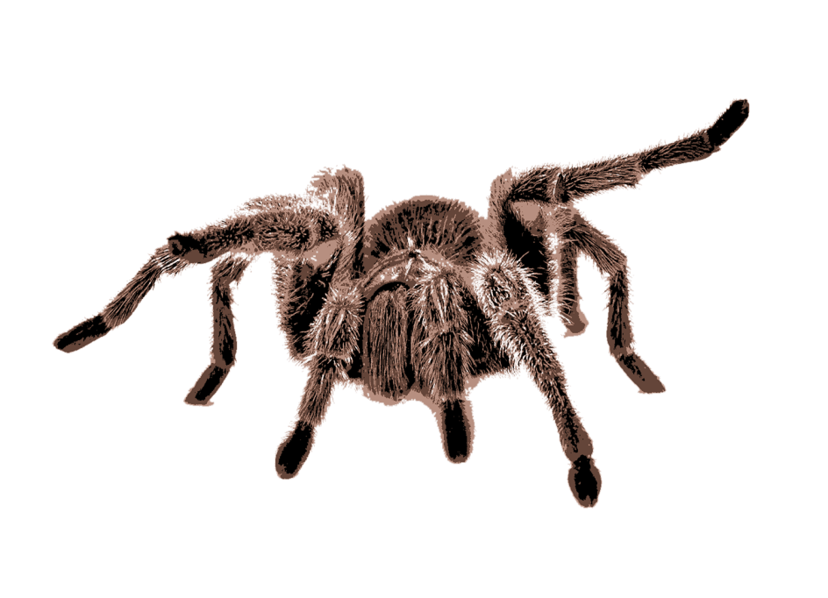
Webcasting

Slide 21
IV Part of Russian Civil Code and Working paper on alternative and non-mandatory solutions on the protection in relation to webcasting
Article 1330, item 2, sub-item 5
Article 2, item (a)
making a broadcast of radio- or television program available to the public in such a way that any person can access it from any place and at any time individually chosen by such person (making available to the public)
“webcasting” means the making accessible to the public of transmissions of sounds or of images or of images and sounds or of the representations thereof, by wire or wireless means over a computer network at substantially the same time. Such transmissions, when encrypted, shall be considered as “webcasting” where the means for decrypting are provided to the public by the webcasting organization or with its consent
The wording used in article 1330, item 2, sub-item 5 of Russian Civil Code should be brought in accordance with the provision of Working paper on alternative and non-mandatory solutions on the protection in relation to webcasting
CONCLUSION
The right to make available under IV Part of Russian Civil Code

Slide 22
Wordings contained in working paper on alternative and non-mandatory solutions on the protection in relation to webcasting and approved by Russian delegation
WEBCASTING (SIMULTANEOUS TRANSMISSIONS)
INTERACTIVE (NON-SIMULTANEOUS) TRANSMISSIONS
means the making accessible to the public of transmissions of sounds or of images or of images and sounds or of the representations thereof, by wire or wireless means over a computer network at substantially the same time
such transmissions, when encrypted, shall be considered as “webcasting” where the means for decrypting are provided to the public by the webcasting organization or with its consent
any transmission, when the time of transmission and the place of its acceptance can be individually chosen by members of the public
NON-SIMULTANEOUS TRANSMISSIONS
SIMULTANEOUS TRANSMISSIONS
THE RIGHT TO MAKE AVAILABLE FOR BROADCASTERS

Slide 23
The operative term of the definition is not “transmission” but “making accessible to the public of transmissions.”
This expression implies the modicum of interactivity in today’s technological environment that is necessary to access the streaming of a program-carrying signal.
It is the receiver who activates or instigates the transmission over a telecommunications path.
The elements “to the public” and “at substantially the same time” serve to limit the definition to accessibility of real-time streaming that may be received by several receivers at the same time.
The receiver may log in to the program flow at a given point of time and receive what follows but cannot influence the program flow otherwise.
The definition confines the making accessible of transmissions to such activity over computer networks, which by nature may take place by wire or wireless means.

Slide 24
Forms of broadcast approved by the Russian delegation
Forms of broadcast
BROADCAST
BROADCAST
Broadcasting organisation
CABLE
Cablecasting organisation
WEB
Webcasting organisation
CABLE
WEB

Slide 25
The wording contained in working paper on alternative and non-mandatory solutions on the protection in relation to webcasting and approved by Russian delegation
“Webcasting organization” means the legal entity that takes the initiative and has the responsibility for the transmission to the public of sounds or of images or of images and sounds or of the representations thereof, and the assembly and scheduling of the content of the transmission

Slide 26
Accession to the WIPO Treaties by the Russian Federation
The date of accession
Entry into force
February 5, 2009
November 5, 2008
(WCT Notification No. 72)
WIPO Copyright Treaty
February 5, 2009
WIPO Performances and Phonograms Treaty
November 5, 2008
(WPPT Notification No. 74)

Slide 27
Do you want to know more?
Is it necessary to change anything in Russian copyright law, especially in the field of collective management?
The history of origination and development of institution "Making Available Right" in international and foreign private law
http://www.kondrin.com
What to do to bring the Russian law in accordance with universally recognised international standards

